Slide 1



Slide 2
Medical Imaging Techniques
Assist. Prof. Luay A. Naeem
Veterinary Surgery

Slide 3
Objects
Medical photography.
Physical concepts of how each technology works.
How the image is produced.

Slide 4
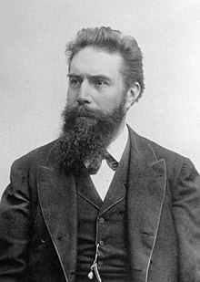
Wilhelm Conrad Rontgen
(1845 – 1923)

Slide 5
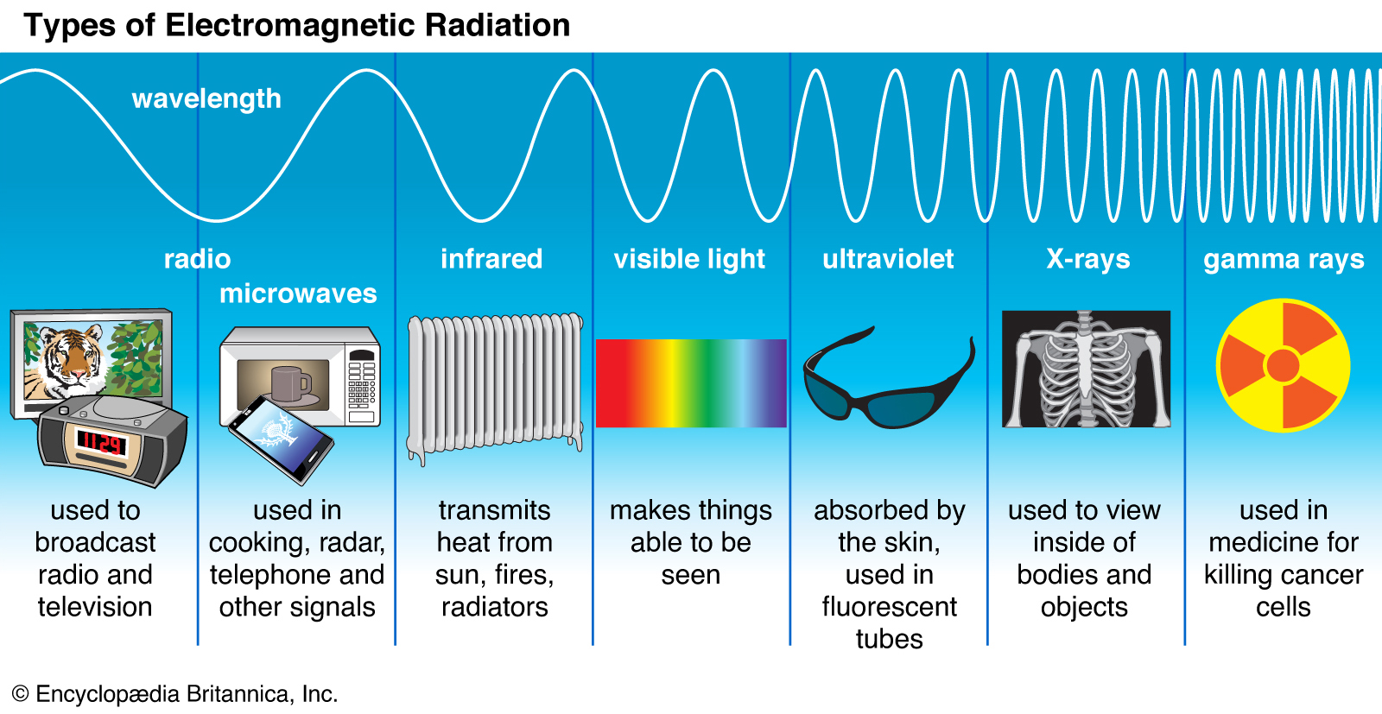

Slide 6
Medical photography
Medical Photography is a broad science in which many concepts are shared scientific, engineering and computer science. and as these sciences developed, they resulted in advanced devices that help the doctor detect the disease easily and accurately high.
Medical Imaging Techniques are the techniques and processes used to obtain Photographs of the animal or human body (or parts thereof) for diagnostic, therapeutic or research.

Slide 7
Medical Imaging Techniques
Basic types diagnostic equipment includes medical imaging machines that used to aid in diagnosis. Examples include:
1- X-rays,
2- Computerized Tomography (CT) scanners,
3- Positron Emission Tomography (PET),
4- Magnetic Resonance Imaging (MRI), and
5- Ultrasound.

Slide 8
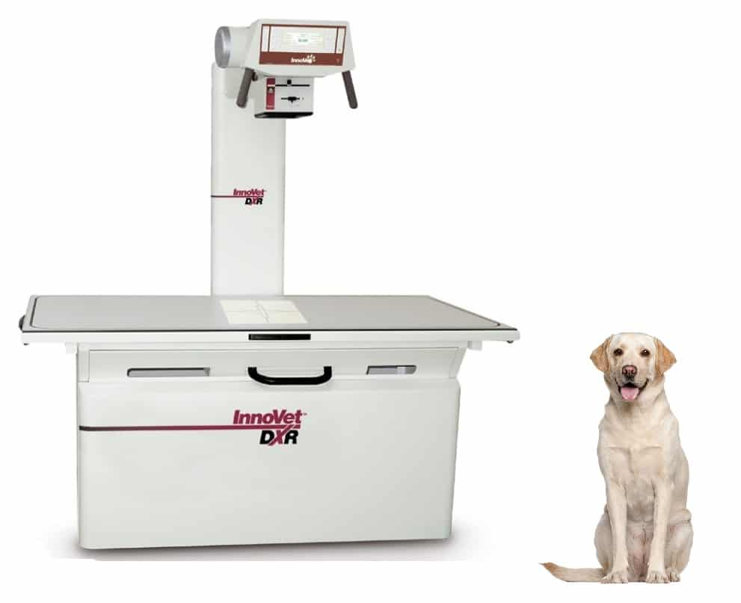

Slide 9
Medical Imaging Techniques
1- x-ray
A form of electromagnetic radiation with very high frequency and energy (10⁻¹⁰). X-rays lie between ultraviolet radiation and gamma radiation on the electromagnetic spectrum

Slide 10
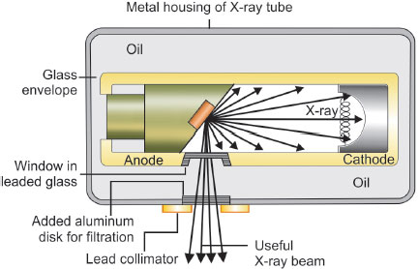

Slide 11
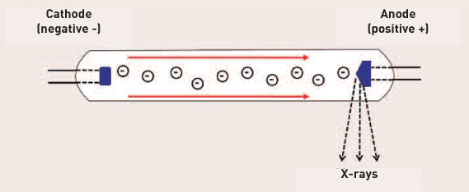

Slide 12
An x-ray machine is like a giant camera that allows doctors to see what is going on inside a patient without having to do surgery.
X-ray is produced when a negatively charged electrode is heated by electricity and electrons are released, thereby producing energy. That energy is directed toward a metal plate, or anode, at high velocity and an X-ray is produced when the energy collides with the atoms in the metal plate

Slide 13
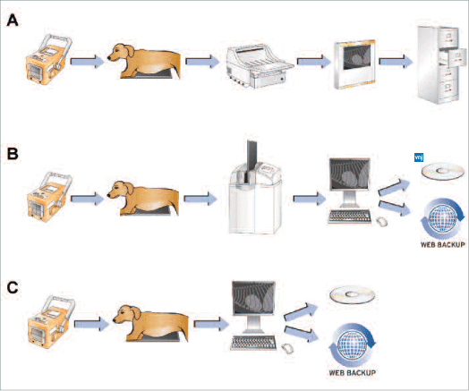

Slide 14
Medical Imaging Techniques
2- Computed Tomography (CT):
Commonly referred to as a Cat Scan or CT scan, uses x-rays and a computer to generate cross-sectional images of a region of interest. In veterinary medicine, a CT scan is often used for imaging of the chest, abdomen, nose, bones and joints.

Slide 15
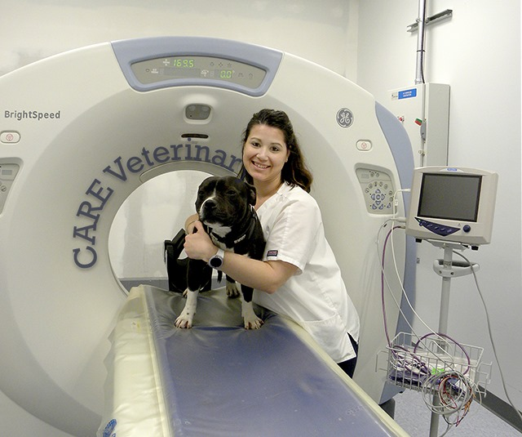

Slide 16
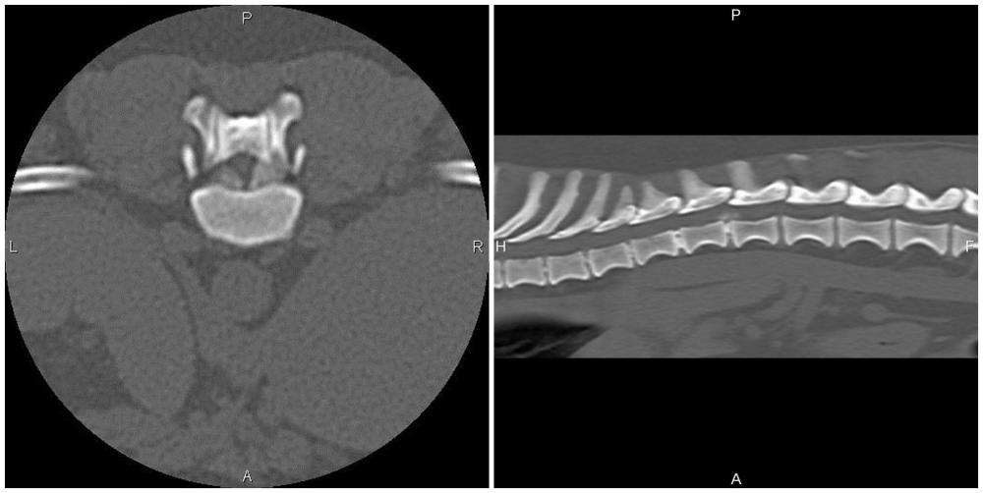

Slide 17
Medical Imaging Techniques
3- Positron Emission Tomography(PET):
Is an imaging technique uses injectable radioactive tracer to detects diseased cells, that also provides functional information, in addition to structural information obtained with computed tomography (CT) that detect early signs of cancer, heart disease and brain disorders. A combination PET-CT scan produces 3D images for a more accurate diagnosis.
Notes:
Non-neurologic Disorders of the Head, Neck, and Teeth

Slide 18
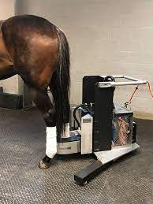
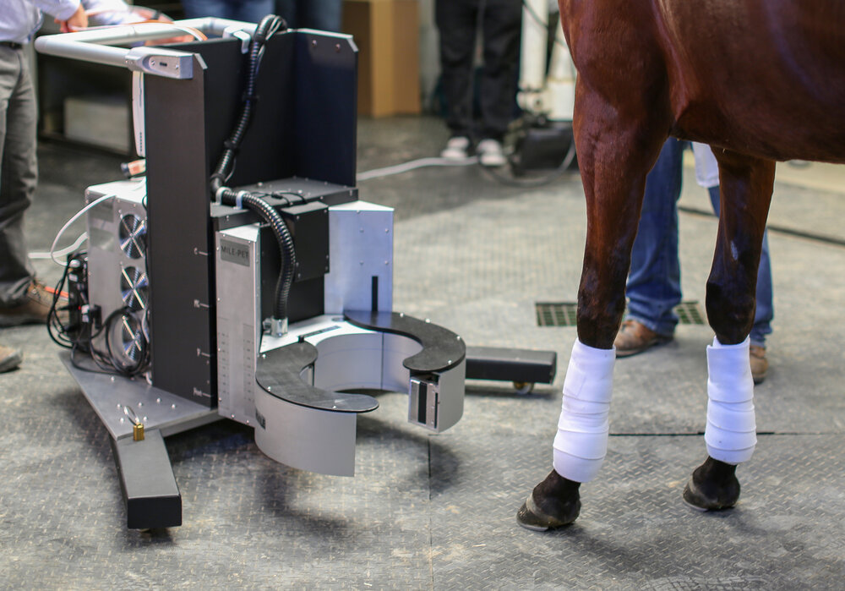

Slide 19
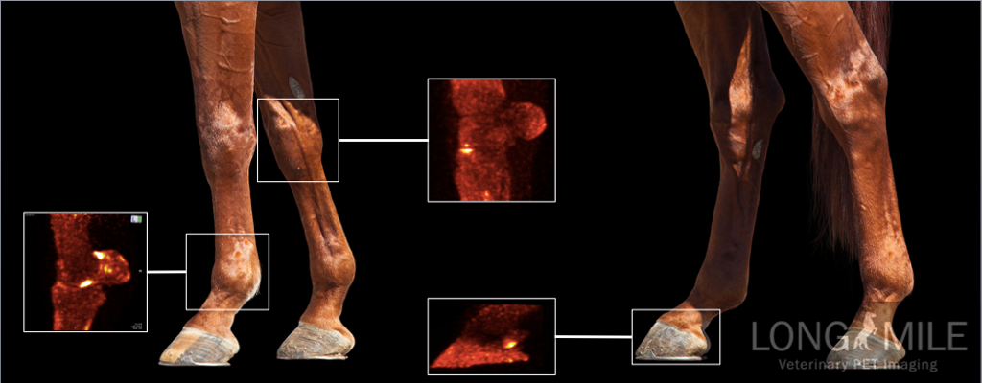

Slide 20
CT Scan VS PET Scan
A CT scans pass x-rays through the body to create images.
A CT scan is performed in minutes.
A PET scan uses a radioactive material which emits energy. The energy is then detected by a special camera to produce images.
A PET scan is more time-consuming.
Notes:
They use different materials

Slide 21
Medical Imaging Techniques
4- Magnetic Resonance Imaging (MRI)
The uses a powerful magnetic field, radio waves and a computer to produce detailed pictures of organs, soft tissues, and other internal body structures. MRI does not use ionizing radiation (x-rays), but detects the motion of protons that are normally present in the cells of body.

Slide 22
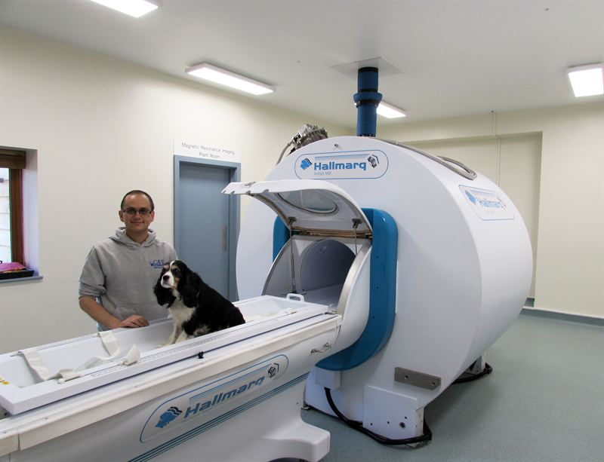

Slide 23
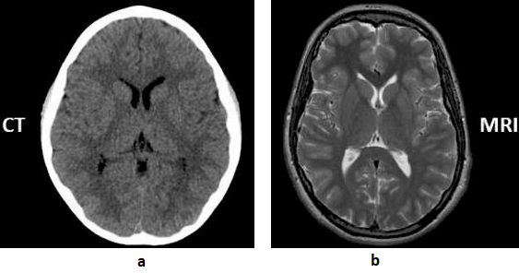

Slide 24
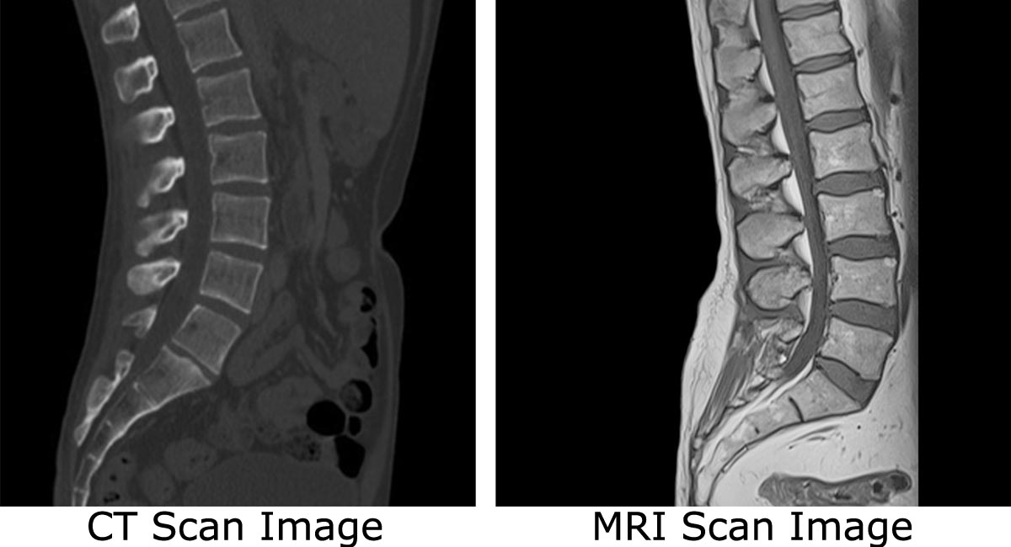

Slide 25
Medical Imaging Techniques
5- Ultrasonography
Ultrasound is the second most commonly used imaging format in veterinary practice. It uses ultrasonic sound waves in the frequency range of 1.5–20 megahertz (MHz) to create images of body structures based on the pattern of echoes reflected from the tissues and organs being imaged.

Slide 26
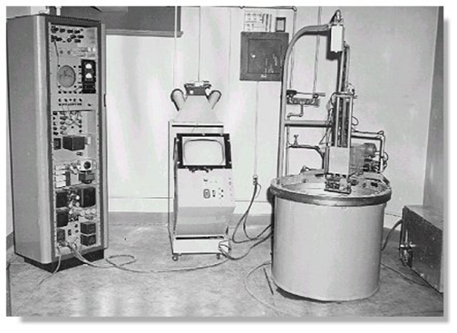
First Medically used in the 1950s

Slide 27
Requirements for Machine
Image
Quality
Ease of
Use
Image& Report
Management
Best Machine
For Use
Special
Features
Cost
Portability
Durability
Service
Upgradeability
Warranty

Slide 28
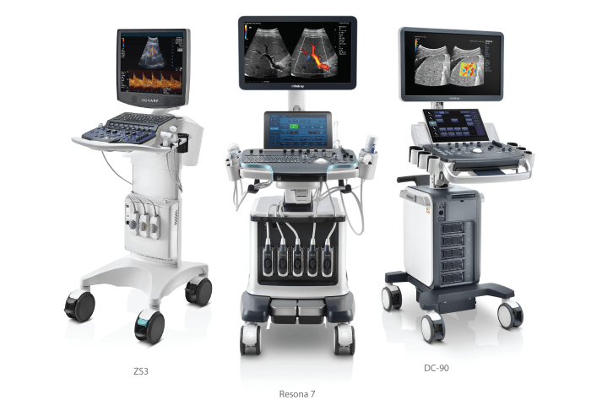

Slide 29
Types of Ultrasounds
Abdominal Ultrasound.
Pelvic Ultrasound Imaging.
Transabdominal.
Transvaginal Ultrasound.
Transrectal.
Obstetric Ultrasound Imaging.
Carotid & Abdominal Aorta Ultrasound Imaging.
Ophthalmic Ultrasound

Slide 30
Modes of Ultrasound
Four different modes of ultrasound are used in medical imaging, these are:
A – Mode
B- Mode
M- Mode
Doppler Mode

Slide 31
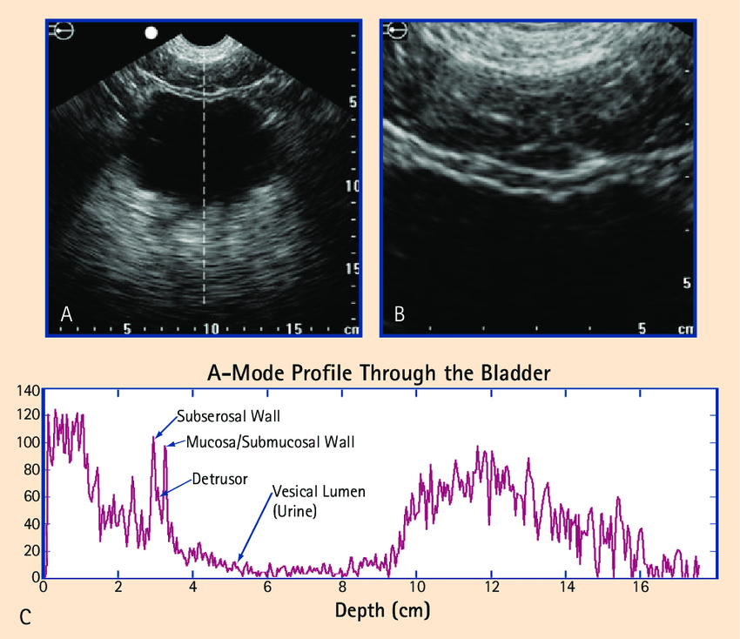

Slide 32
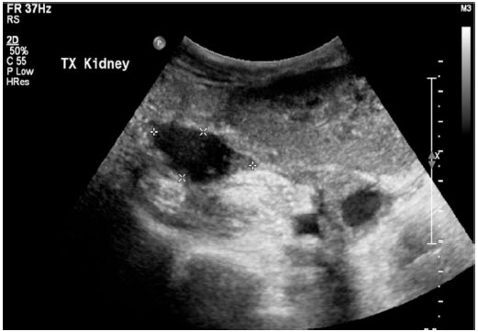

Slide 33
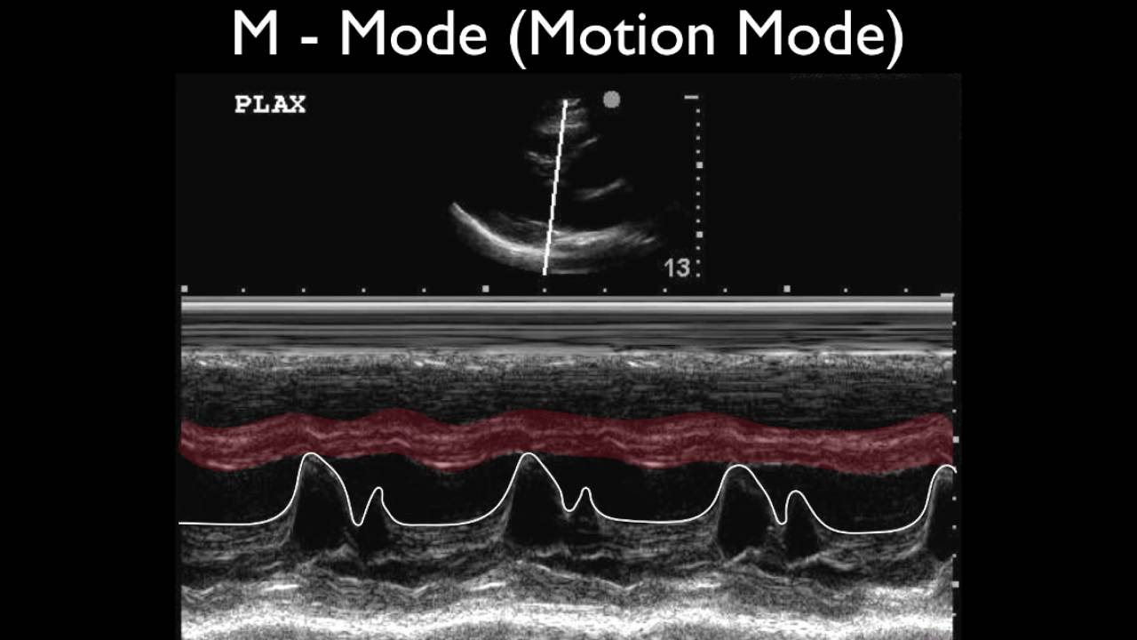

Slide 34
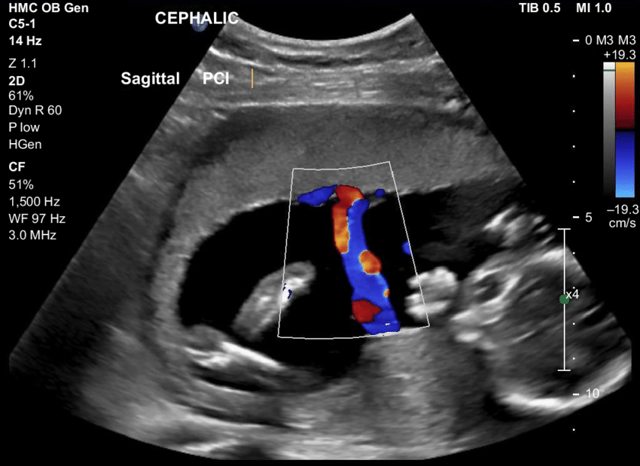

Slide 35
X-ray
Definition: X-rays are a type of radiation called electromagnetic waves. X-ray imaging creates pictures of the inside of body. The images show the parts of body in different shades of black and white. This is because different tissues absorb different amounts of radiation. Calcium in bones absorbs x-rays the most, so bones look white. Fat and other soft tissues absorb less and look gray. Air absorbs the least, so lungs look black.

Slide 36
X-ray properties
They have a shorter wavelength of the electromagnetic spectrum.
Requires high voltage to produce X-Rays.
They are used to capture the human skeleton defects.
They travel in a straight line and do not carry an electric charge with them.
They are capable of travelling in a vacuum.
X-rays can not be seen, felt, tasted, smelled.
X-rays are highly penetrable.
X-rays cause biological effects.

Slide 37
X-Rays Uses
Since the discovery of X-radiation, they are used in various fields and for various purposes. Some key uses of X-Ray are given below.
Medical Science
Security
Astronomy
Industry
Restoration

Slide 38
Radiographers and radiologists
The two types of health practitioners involved in x-ray examinations are:
a radiographer who conducts the examination and is trained to create the best quality images as safely as possible.
a radiologist (a medical specialist) who is trained to interpret x-ray images.

Slide 39
X-ray machine
An X-ray machine is any machine that involves X-rays. It may consist of an X-ray generator and an X-ray detector.

Slide 40
How Does an X-Ray Work?
x-ray machines produce a stream of electromagnetic radiation that interacts with an anode in an x-ray tube. The x-rays made by this interaction are then directed toward the part of the body being examined. To reduce radiation exposure, x-ray machines aim the x-rays at only the focus area.

Slide 41
Cont…..
An X-ray is produced when a negatively charged electrode is heated by electricity and electrons are released, thereby producing energy. That energy is directed toward a metal plate, or anode, at high velocity and an X-ray is produced when the energy collides with the atoms in the metal plate.

Slide 42


Slide 43
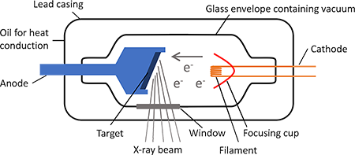

Slide 44
How an X-ray image is created
When to get an X-ray, a cassette is placed behind or under the area of concern. This cassette holds the film that will be exposed by the X-ray. As the X-ray enters the body, it passes through skin, muscles, and organs, as this type of soft tissue cannot absorb the energy of the X-ray. This appears dark on the film as it is now exposed. However, bone absorbs X-ray energy and does not expose the film. This area appears light or white on the film.

Slide 45
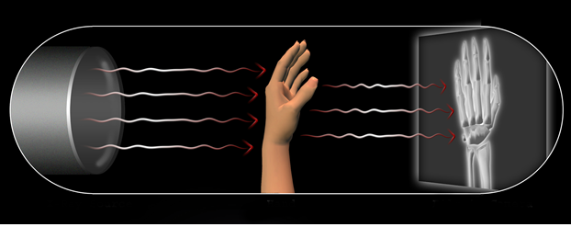

Slide 46
When x-ray examinations are used
Diagnosis of fractures – detection of broken bones is one of the most common uses of this test.
Diagnosis of dislocations – an x-ray examination can reveal if the bones of a joint are abnormally positioned.
As a surgical tool – to help the surgeon accurately perform the operation. For example, x-ray images taken during orthopaedic surgery show if the fracture is aligned or if the implanted device (such as an artificial joint) is in position. X-rays may also be used in other surgical procedures for a similar purpose.
Diagnosis of bone or joint conditions – for example, some types of cancer, arthritis or osteoporosis.
Diagnosis of chest conditions – such as pneumonia, lung cancer, emphysema or heart failure.
Detection of foreign objects – for example, metal fragments or swallowed coins.

Slide 47


